Slide 1
Connect 4 Using Reinforcement Learning
Team members Group 7:
Kritagya Kumra
Akash Chavan
Daniel Macias
Janvi Navdiya
Jaswanth Reddy Botta
Professor — Christian Fagan

Slide 2
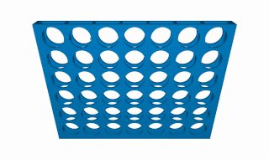
Reinforcement Learning in Connect 4 By Group 7
Report :-
https://docs.google.com/document/d/1yMLEN2Eut0YqTm4VDjYyKaDaWPodZEqHzq30XgNxITk/edit
Github Repository:-
https://github.com/Kritagya-web/Connect4-AI-Reinforcement-Learning-Final-Project-CalStateLA

Slide 3
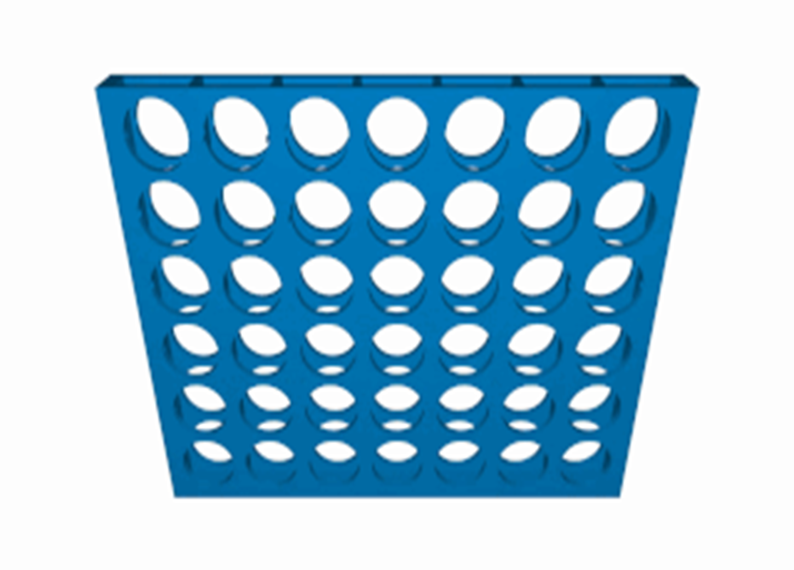
Introduction
The Connect 4 game is a classic strategy game, where players take turns dropping colored discs into a vertical grid.
The game is played on a vertical grid with seven columns and six rows.
Players alternately drop colored discs into the columns from the top; these discs are often red or yellow.
The game goes on until all available spots are filled or until a player creates a line of four discs of the same color, either diagonally, vertically, or horizontally.

Slide 4
Explaining a bit about the game environment
We are using kaggle_environment to create and load the Connect4 Game environment. from kaggle_environments import make, evaluate
# Create the game environment
# Set debug=True to see the errors if your agent refuses to run
env = make("connectx", debug=True) # List of available default agents
print(list(env.agents))
In the game of Connect Four, a random agent selects its moves uniformly at random from the set of valid moves. In Connect Four, a move is considered valid if there's still space in the column to place a disc
# Two random agents play one game round
env.run(["random", "random"])
# Show the game
env.render(mode="ipython")

Slide 5
Defining Agents In connect 4 , agent is a function which decide the column in which the next disc will be dropped and it makes decision on the current state of the game. Two key parameter passed to the agent : obs and config obs contain two pieces information : 1> obs.board & 2>obs.mark config contains three pieces of information: 1>config.column & 2>config.rows
3>config.inarow
# Selects random valid column
def agent_random(obs, config):
valid_moves = [col for col in range(config.columns) if obs.board[col] == 0]
return random.choice(valid_moves)
# Selects middle column
def agent_middle(obs, config):
return config.columns//2

Slide 6
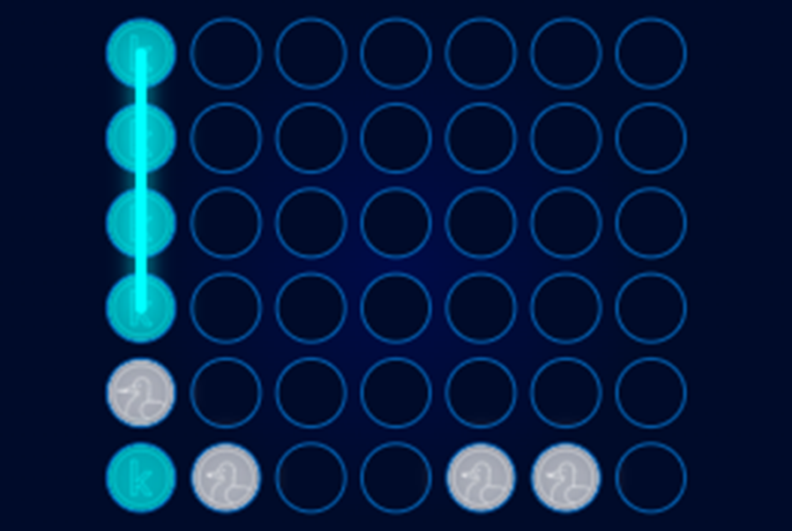
Evaluating Agents One method for evaluation is calculating win percentages over multiple games. We play our agents against each other over hundreds of rounds, tracking the frequency of each agent's victory, using the get_win_percentages function. get_win_percentages(agent1=agent_middle, agent2=agent_random) Agent 1 Win Percentage: 0.65
Agent 2 Win Percentage: 0.0
Number of Invalid Plays by Agent 1: 35
Number of Invalid Plays by Agent 2: 0

Slide 7
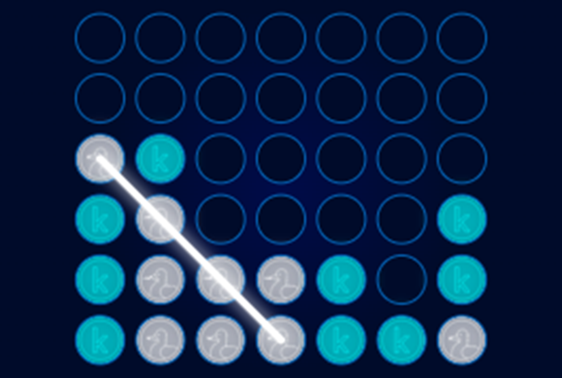
Outcome of the game played by these agents
We assess agents by having them play simulated games, and then we look at the results to see how well they work.
The result includes each agent's win percentage, average score, and other pertinent metrics.
To understand the strengths and weaknesses of agents, we analyze their performance against a variety of opponents and in different game scenarios.

Slide 8
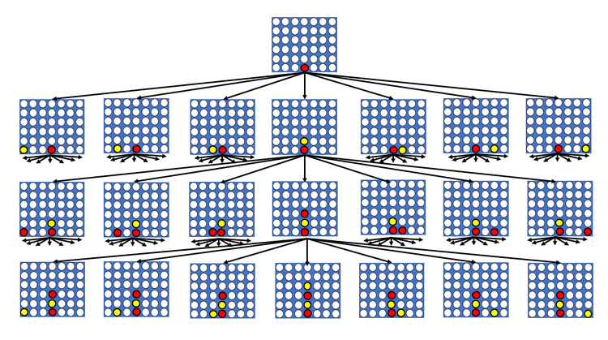
Game Trees
Game trees are a fundamental concept in game theory and computer science
They are graphical representations of all possible moves and outcomes in a sequential game.
Each node in the tree represents a game state, and the edges represent possible moves or decisions that can be made from that state.
Terminal nodes are the endpoints of the game tree branches. They represent final outcomes or states where the game ends, either in a win, loss.

Slide 9
Heuristic function
The complete game tree for Connect 4 has over 4 trillion different boards in practice our implemented agent only works with a small subset to plan the next move.
To make sure the incomplete tree is still useful we use a heuristic function.
This heuristic function assigns scores to different game boards, where we estimate that boards with higher scores that are more likely to result in the agent winning the game.
For example
if the agent has four discs in a row it would win the game and get the most points for that move
If the agent filled three spots, and the remaining spot is empty you would only get one point
If the opponent filles three spots, and the remaining spot is empty you would mark it as a negative gain

Slide 10
Implementation
One step look forward:
Current Game State: Suppose we have a 6x7 game board were player one already has drop his piece into any of the seven columns, and now is the agents turn to make a move. Then the agent can drop his piece into any of the seven columns where there is still space available and each column represents a possible move.
Expanding the Game Tree: The algorithm creates a tree with seven child nodes, each representing the potential game state from dropping a piece into one of the seven columns. These nodes are connected to the current game state by edges representing the respective moves.
Choosing the Best Move: For each of the seven potential game states, we consider what the resulting game board would look like as we analyze the potential outcome base on the heuristic function, and then the agent chooses the move that has the highest gain.

Slide 11
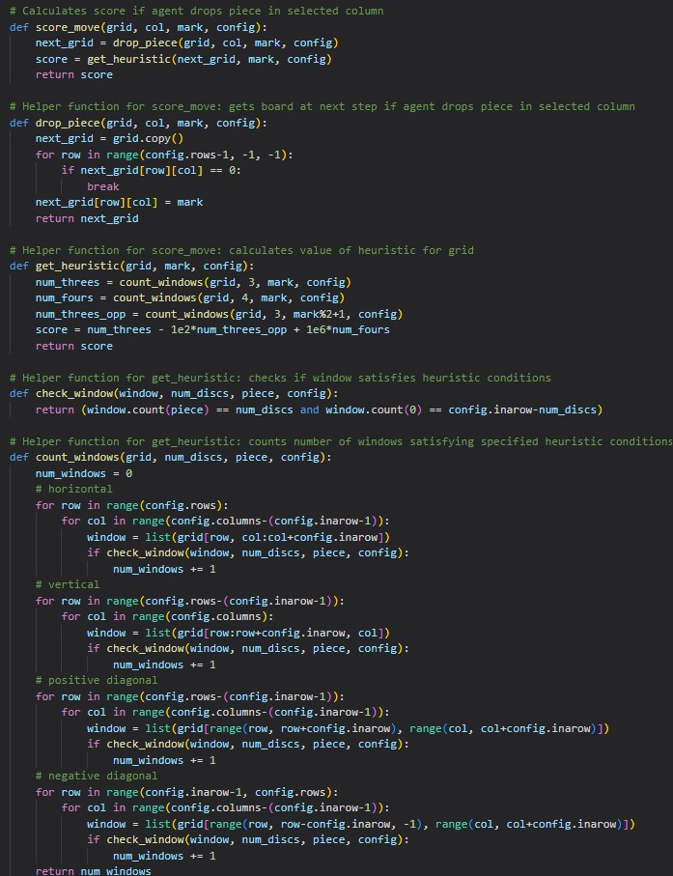
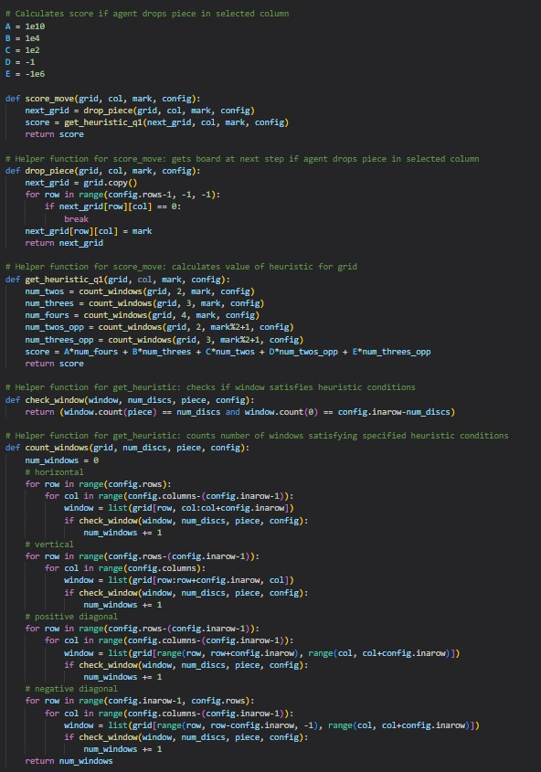
Code

Slide 12
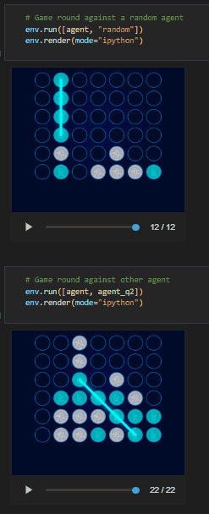
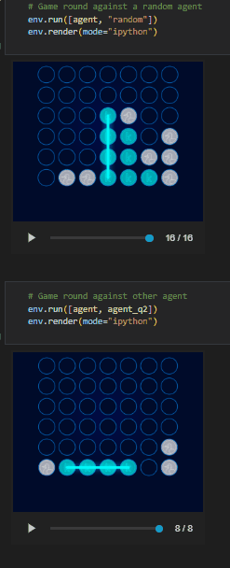
Demo

Slide 13
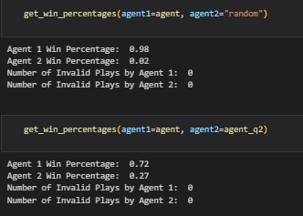
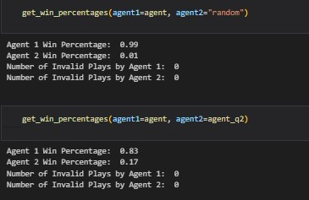
Results

Slide 14
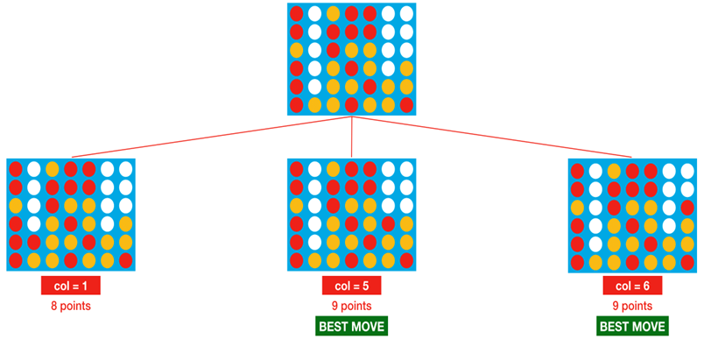
N-Step Lookahead
Introduction
In the previous slides, you learned how to build an agent with one-step lookahead. This agent performs reasonably well, but definitely still has room for improvement!
For instance, consider the potential moves in the figure below. (Note that we have use zero-based numbering where the leftmost column corresponds to col=0 with last column being col = 6.)
With one-step lookahead, the red player picks one of column 5 or 6, each with 50% probability as it has more reward associated. But column 5 is clearly a bad move, as it lets the opponent win the game in only one more turn. Unfortunately, the agent doesn't know this, because it can only look one move into the future.
Hence, what we thought of next step was to overcome this issue and use the minimax algorithm to help the agent look farther into the future and make better-informed decisions.

Slide 15
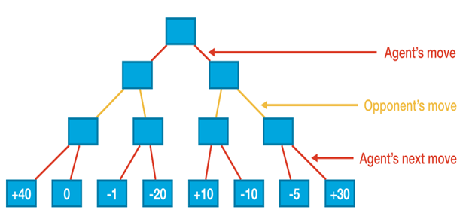
MiniMax Algorithm
Assume we're working with a depth of 3. This way, when choosing on a move, the agent examines all conceivable game boards that could result from the agent's move, the opponent's move, and the agent's subsequent move. For simplicity, we assume that at each turn, both the agent and opponent have only two possible moves. Each of the blue rectangles in the figure below corresponds to a different game board.
But the agent no complete control over its score and is dependent on the opponent’s move to attain big scores and thus the opponent's selection can prove disastrous for the agent in some case for instance, If the agent picks the left branch, the opponent can force a score of -1.
You would see that the right branch is the better the agent, since it is the less risky option as it gives up the score (+40) that can be accessed on the left, but it also guarantees at least +10 points in the right.
This is the main idea behind the minimax algorithm: where the agent chooses moves to get a high score possible assuming the opponent will counteract to move the score to be as low as possible.
Labeled scores from the heuristic mentioned In previous slides with agent’s goal being to end up with a score that's as high as possible.

Slide 16
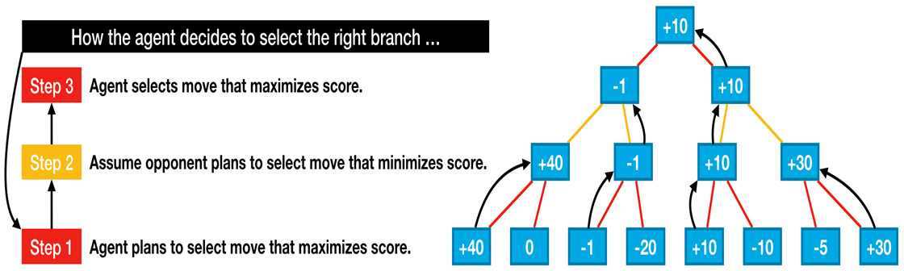
Agent’s Thinking process while selecting a move

Slide 17
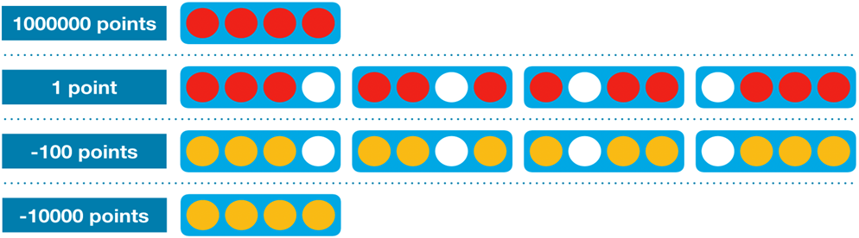
Transition into Minimax Approach using Minimax Heuristics
We'll need to slightly modify the heuristic from the previous slides, since the opponent is now able to modify the game board results based upon its move.
We need to check if the opponent has won the game by playing a disc. The new heuristic looks at each group of four adjacent locations in a (horizontal, vertical, or diagonal) line and assigns:
·1000000 (1e6) points if the agent has four discs in a row (the agent won),
·1 point if the agent filled three spots, and the remaining spot is empty (the agent wins if it fills in the empty spot),
·-100 points if the opponent filled three spots, and the remaining spot is empty (the opponent wins by filling in the empty spot), and
·-10000 (-1e4) points if the opponent has four discs in a row (the opponent won).

Slide 18
# Helper function for minimax: calculates value of heuristic for grid
def get_heuristic(grid, mark, config):
num_threes = count_windows(grid, 3, mark, config)
num_fours = count_windows(grid, 4, mark, config)
num_threes_opp = count_windows(grid, 3, mark%2+1, config)
num_fours_opp = count_windows(grid, 4, mark%2+1, config)
score = num_threes - 1e2*num_threes_opp - 1e4*num_fours_opp + 1e6*num_fours
return score
In the next code cell, we define a few additional functions that we'll need for the minimax agent.
# Uses minimax to calculate value of dropping piece in selected column
def score_move(grid, col, mark, config, nsteps):
next_grid = drop_piece(grid, col, mark, config)
score = minimax(next_grid, nsteps-1, False, mark, config)
return score
In this function we would calculate the heuristic scores by counting the number of three pairs, four pairs we have for our agent and the opponent and would calculate the score based upon that for entire grid.
This function calculates the score of dropping a piece in a selected column using a heuristic evaluation. The heuristic evaluation is a way to assess the "goodness" of a move based on the current state of the board.

Slide 19
# Helper function for minimax: checks if agent or opponent has four in a row in the window
def is_terminal_window(window, config):
return window.count(1) == config.inarow or window.count(2) == config.inarow
# Helper function for minimax: checks if game has ended
def is_terminal_node(grid, config):
# Check for draw
if list(grid[0, :]).count(0) == 0:
return True
This function checks if a window (a sequence of adjacent cells) contains four pieces in a row belonging to either the player or the opponent.
This function checks if the game has ended by either a win, loss, or draw.

Slide 20
# Check for win: horizontal, vertical, or diagonal
# horizontal
for row in range(config.rows):
for col in range(config.columns-(config.inarow-1)):
window = list(grid[row, col:col+config.inarow])
if is_terminal_window(window, config):
return True
# vertical
for row in range(config.rows-(config.inarow-1)):
for col in range(config.columns):
window = list(grid[row:row+config.inarow, col])
if is_terminal_window(window, config):
return True

Slide 21
# positive diagonal
for row in range(config.rows-(config.inarow-1)):
for col in range(config.columns-(config.inarow-1)):
window = list(grid[range(row, row+config.inarow), range(col, col+config.inarow)])
if is_terminal_window(window, config):
return True
# negative diagonal
for row in range(config.inarow-1, config.rows):
for col in range(config.columns-(config.inarow-1)):
window = list(grid[range(row, row-config.inarow, -1), range(col, col+config.inarow)])
if is_terminal_window(window, config):
return True
return False

Slide 22
# Minimax implementation
def minimax(node, depth, maximizingPlayer, mark, config):
is_terminal = is_terminal_node(node, config)
valid_moves = [c for c in range(config.columns) if node[0][c] == 0]
if depth == 0 or is_terminal:
return get_heuristic(node, mark, config)
if maximizingPlayer:
value = -np.Inf
for col in valid_moves:
child = drop_piece(node, col, mark, config)
value = max(value, minimax(child, depth-1, False, mark, config))
return value
else:
value = np.Inf
for col in valid_moves:
child = drop_piece(node, col, mark%2+1, config)
value = min(value, minimax(child, depth-1, True, mark, config))
return value
This function implements the minimax algorithm, which is a recursive algorithm used to choose the best move for the current player, assuming the opponent also plays optimally.
Explanation of the function
If the depth is 0 or the game has ended, it returns the heuristic value of the node.
After that we would have two cases where firstly, it is thinking about maximizing its output when it is his turn and secondly, it is minimizing the output when it is opponents turn
If it's the maximizing player's turn, it calculates the maximum possible score for the current node by recursively calling minimax for all possible moves.
If it's the minimizing player's turn, it calculates the minimum possible score for the current node by recursively calling minimax for all possible opponent moves.

Slide 23
Testing MiniMax with the random agent
def agent(obs, config):
# Get list of valid moves
valid_moves = [c for c in range(config.columns) if obs.board[c] == 0]
# Convert the board to a 2D grid
grid = np.asarray(obs.board).reshape(config.rows, config.columns)
# Use the heuristic to assign a score to each possible board in the next step
scores = dict(zip(valid_moves, [score_move(grid, col, obs.mark, config, N_STEPS) for col in valid_moves]))
# Get a list of columns (moves) that maximize the heuristic
max_cols = [key for key in scores.keys() if scores[key] == max(scores.values())]
# Select at random from the maximizing columns
return random.choice(max_cols)
The function selects a move based on a heuristic evaluation of the current board state. It assesses each possible move's desirability, chooses the moves that maximize the heuristic score, and randomly selects one of them.

Slide 24
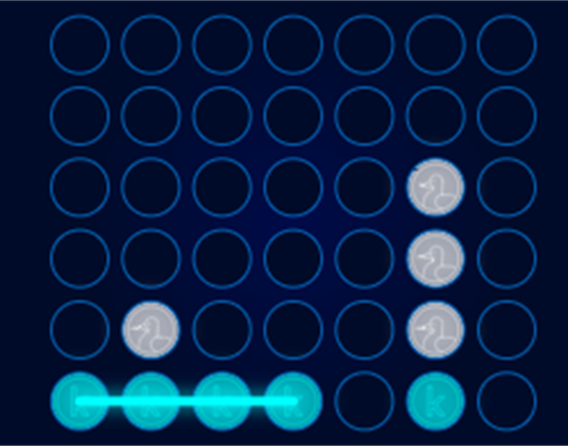
Testing MiniMax with the random agent
from kaggle_environments import make, evaluate`
# Create the game environment
env = make("connectx")
# Two random agents play one game round
env.run([agent, "random"])
# Show the game
env.render(mode="ipython")

Slide 25
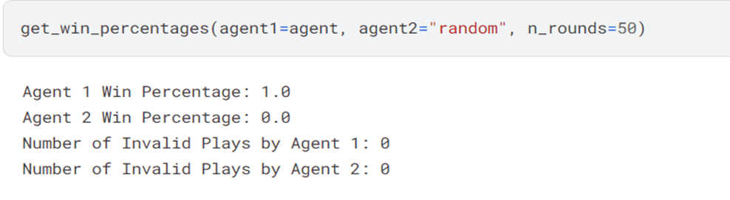
Testing MiniMax with the random agent
Check the modal accuracy with win percentage

Slide 26
Reinforcement Learning
Introduction
So far, our agents have relied on detailed information about how to play the game.
The heuristic really provides a lot of guidance about how to select moves

Slide 27
Reinforcement Learning
Limitations of Heuristics
Time-consuming to design and maintain.
Inflexible to changing game environments.

Slide 28
Reinforcement Learning
Introducing Reinforcement Learning (RL)
Trains AI agents through gameplay, not predefined rules.
Agents learn by trial and error, adapting their strategies.
We have used Reinforcement Learning to build an intelligent agent without the use of a heuristic.
Instead, we will gradually refined the agent's strategy over time, simply by playing the game and trying to maximize the winning rate.

Slide 29
Reinforcement Learning
Neural Networks
Creating a perfect heuristic is difficult
Requires extensive gameplay to identify suboptimal decisions
Analyzing specific instances for better choice opportunities
Difficult to pinpoint errors accurately
Fixing mistakes may inadvertently create new issues.

Slide 30
Reinforcement Learning
Neural Networks
Question: Could a more systematic approach using gameplay experience simplify improvement?
Answer:
Replace heuristics with Neural Networks
Network Functionality:
Input: Current board configuration
Output: Probability for each potential move

Slide 31
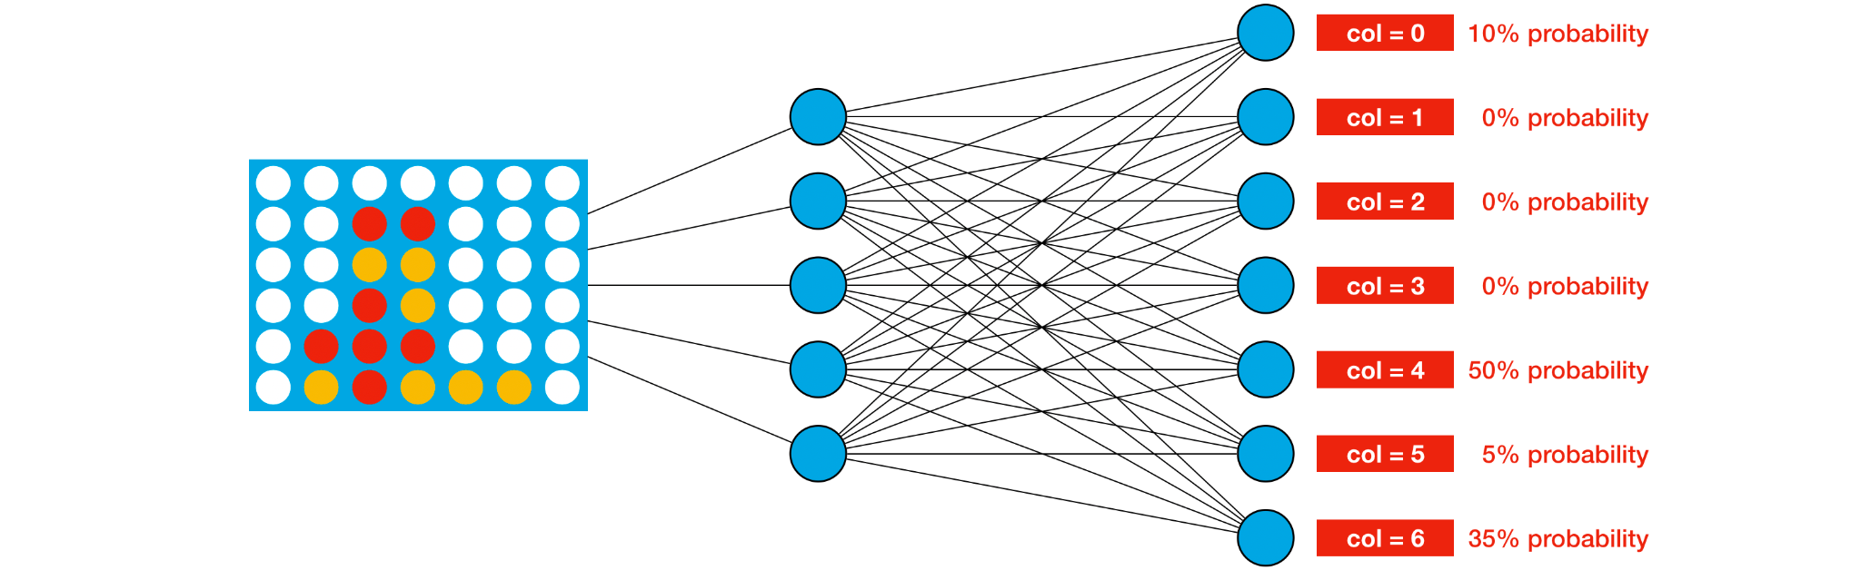
Reinforcement Learning
Move Selection Process
Agent uses a probabilistic approach based on neural network output.
Example: For given game board, selects column 4 with a 50% probability.
Adjust network weights to favor better moves for any possible board.

Slide 32
Reinforcement Learning
Theoretical vs Practical:
Goal: Optimize move probabilities across all game scenarios
Challenge: Impractical to test due to over 4 trillion possible game boards in Connect Four.

Slide 33
Reinforcement Learning
Setup
Objective: How to amend the weights of the network in practical scenarios?
Method: Adjusting weights based on game outcomes and rewards
Rewards System Explained
Winning Move: Reward of +1
Invalid Move: Penalty of -10 (game-ending move)
Opponent Wins Next Move: Penalty of -1 (failure to prevent win)
All Other Moves: Small reward of 1/42 per move
Optimization Goal and Reinforcement Learning
Maximize agent’s average cumulative reward.
Core principles of Reinforcement Learning.
Utilize various reinforcement learning algorithms to optimize network weights.

Slide 34
Reinforcement Learning
Many different RL algorithms like DQN, A2C, and PPO
All use similar process to product an agent
Initialize weights to random values
The algorithm continually tries out new values for the weights
The algorithm settles towards weights that perform better after playing many games
We used the Proximal Policy Optimization (PPO) algorithm to create an agent.

Slide 35
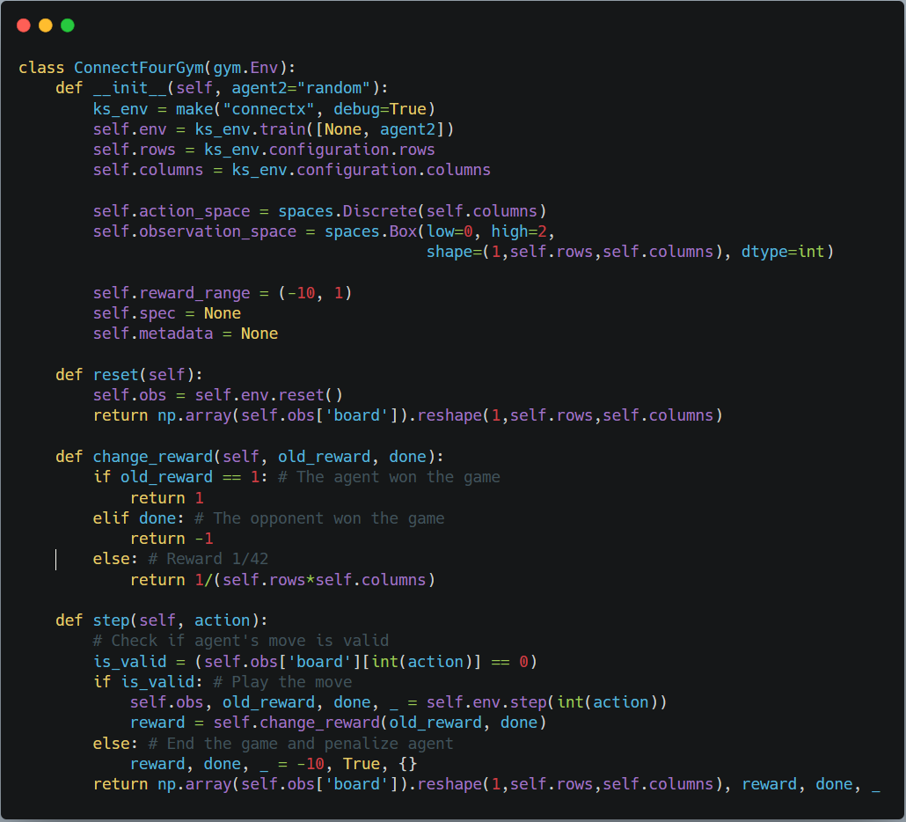
Reinforcement Learning
Code
Framework Used: Stable-Baselines3 for implementing reinforcement learning algorithms.
Purpose: Ensure compatibility with our game environment.
Creating Connect4Gym Game Class
Implementation: ConnectX as an OpenAI Gym environment.
Key Methods:
reset(): Initializes each game with a 6x7 2D numpy array representing the game board
change_reward(): Customizes rewards to align with our designed reward system, different from the competition's ranking rewards
step(action): Executes an action and opponent's response, returns:
Updated game board as a numpy array
Reward from the most recent move (+1, -10, -1, or 1/42)
Game status (done=True if game ends, else done=False)

Slide 36
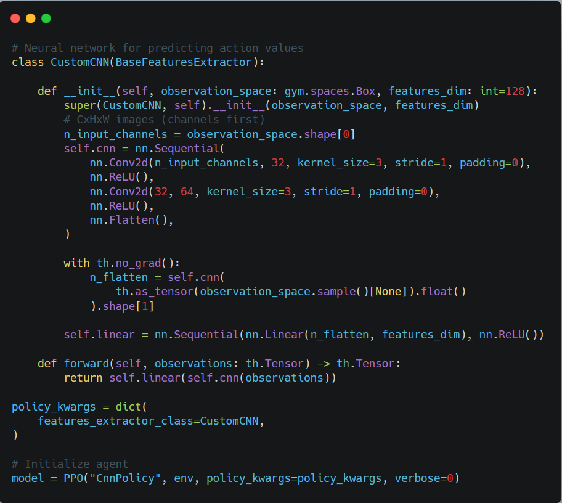
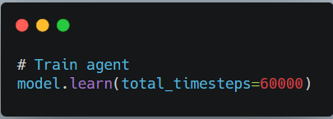
Reinforcement Learning
Next,
Specify the architecture of the Neural Network.
We used Convolutional Neural Network (CNN).
The Network outputs the probabilities of selecting each column.

Slide 37
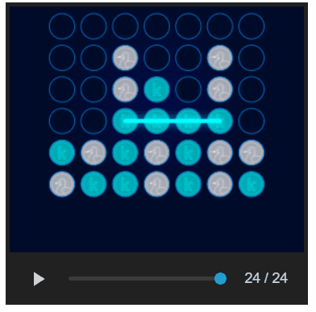
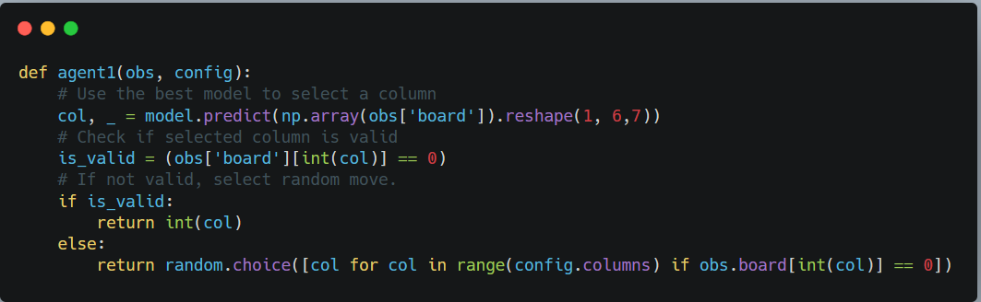
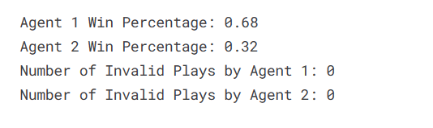
Reinforcement Learning

Slide 38


